Slide 1
Vilano Beach Christian Church
The Windsor Campus
https://www.vilanobeachcc.org/

Slide 2
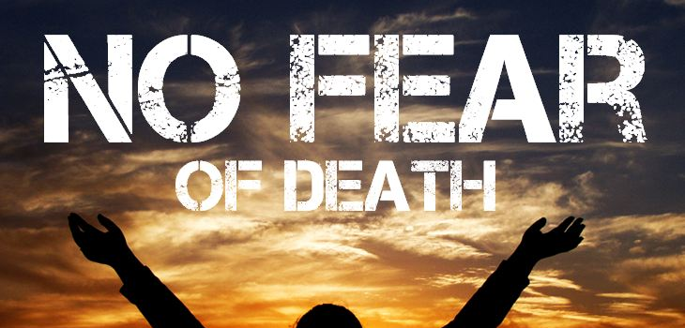

Slide 3
Main Idea
Fear of the Lord can conquer the fear of death.

Slide 5
Fear of the Lord
God is a great, mighty, & awesome Lord
17 For the Lord your God is the God of gods and the Lord of lords, the great, the mighty, and the awesome God who does not show partiality nor take a bribe. (Deuteronomy 10:17 NASB)

Slide 6
Fear of the Lord
Fear of the Lord is reverence & awe of God
28 Therefore, since we are receiving a kingdom that cannot be shaken, let us be thankful, and so worship God acceptably with reverence and awe, 29 for our “God is a consuming fire.” (Hebrews 12:28-29 NIV)

Slide 7
Fear of the Lord
Fear of the Lord also includes understanding how much God hates sin & fearing His judgment on sin—even in the life of a believer
We should fear God’s discipline & seek to live our lives in such a way that pleases Him
Believers are not to be afraid of God

Slide 8
Fear of the Lord
We have His promise that
Nothing can separate us from His love (Rom. 8:38-39)
He will never leave us or forsake us (Hebrews 13:5)
Fearing God means having such a reverence for Him that it has a great impact on the way we live our lives

Slide 9
Fear of the Lord
The fear of the Lord is
Respecting Him
Obeying Him
Submitting to His discipline
Worshiping Him in awe

Slide 10
John 5 (NIV)
24 “Very truly I tell you, whoever hears my word and believes him who sent me has eternal life and will not be judged but has crossed over from death to life.”

Slide 12
From Death Unto life
The Bible presents death as separation
Physical death is the separation of the soul from the body
Spiritual death is the separation of the soul from God
Death is the result of sin
23 For the wages of sin is death, but the gift of God is eternal life in Christ Jesus our Lord. (Romans 6:23 NIV)

Slide 13
From Death Unto life
God warned Adam that the penalty for disobedience would be death
17 “but you must not eat from the tree of the knowledge of good and evil, for when you eat from it you will certainly die.” (Genesis 2:17 NIV)
When Adam disobeyed, he experienced
Spiritual death
Physical death

Slide 14
From Death Unto life
The world is subject to death, because all have sinned
12 Therefore, just as sin entered the world through one man, and death through sin, and in this way death came to all people, because all sinned (Romans 5:12 NIV)
Adam died because he was a sinner
On the cross, Jesus experienced physical & spiritual death
He had never sinned, but chose to die as a substitute for sinners (Hebrews 2:9)

Slide 15
From Death Unto life
Jesus showed His power over death & sin by rising from the dead on the third day
Because of Christ, death is a defeated foe
55 “Where, O death, is your victory? Where, O death, is your sting?” (1 Corinthians 15:55 NIV)
For the unsaved, death ends the chance to accept God’s gracious offer of salvation
27 Just as people are destined to die once, and after that to face judgment, (Hebrews 9:27 NIV)

Slide 16
From Death Unto life
For the saved, death ushers us into the presence of Jesus
8 We are confident, I say, and would prefer to be away from the body and at home with the Lord. (2 Corinthians 5:8 NIV)
So real is the promise of the believer’s resurrection that the physical death of a Christian is called sleep (1 Corinthians 15:51)
We can look forward to that time when there shall be no more death (Revelation 21:4)

Slide 17
Revelation 21 (NIV)
4 ‘He will wipe every tear from their eyes. There will be no more death’ or mourning or crying or pain, for the old order of things has passed away.” 5 He who was seated on the throne said, “I am making everything new!” Then he said, “Write this down, for these words are trustworthy and true.”

Slide 18
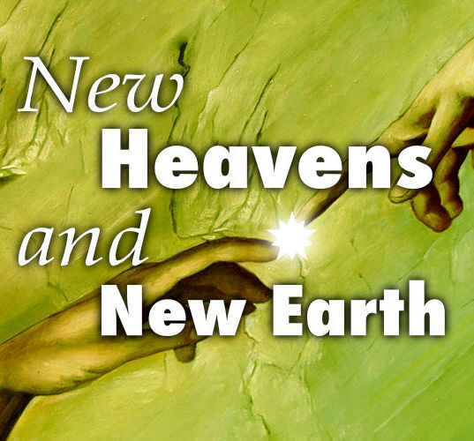

Slide 19
New Heavens and Earth
The current heavens & earth are subject to God’s curse because of mankind’s sin
The new earth & the new heavens are sometimes referred to as the “eternal state”
The new earth will be the eternal dwelling place of believers in Jesus Christ

Slide 20
New Heavens and Earth
Things will be completely new & the old order of things, with the accompanying sorrow & tragedy, will be gone
The new earth will be free from sin, evil, sickness, suffering & death
It will be like our current earth, but without the curse of sin
It will be earth as God originally intended it to be
It will be Eden restored

Slide 21
New Heavens and Earth
A major feature of the new earth will be the New Jerusalem
John calls it the Holy City
This glorious city, with its streets of gold & pearly gates, is situated on a new & glorious earth
This city represents the final state of redeemed mankind, forever in fellowship with God
(Revelation 22:3–4)

Slide 22
New Heavens and Earth
3 No longer will there be any curse. The throne of God and of the Lamb will be in the city, and his servants will serve him. 4 They will see his face, and his name will be on their foreheads. (Revelation 22:3-4 NIV)

Slide 23
New Heavens and Earth
In the new heavens & new earth, Scripture says, there are seven things that are “no more
Sea (Revelation 21:1)
Death (Revelation 21:4)
Mourning (Revelation 21:4)
Weeping (Revelation 21:4)
Pain (Revelation 21:4)
Curse (Revelation 22:3)
Night (Revelation 22:5)

Slide 24
Question
Has your fear of the Lord conquered your natural fear of death?

Slide 26
Vilano Beach Christian Church
The Windsor Campus
https://www.vilanobeachcc.org/

