Slide 2
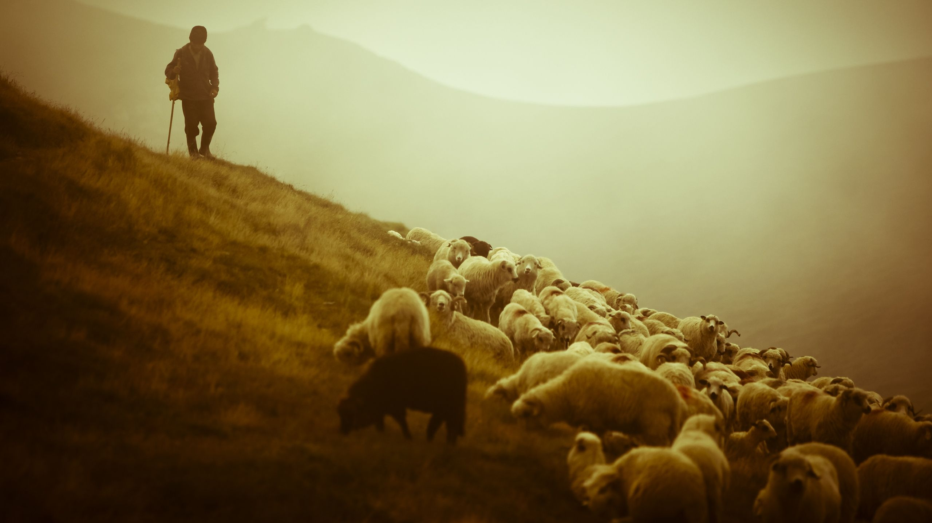
Jesus,
The Good Shepherd

Slide 3
John 10 (NIV)
1 “Very truly I tell you Pharisees, anyone who does not enter the sheep pen by the gate, but climbs in by some other way, is a thief and a robber. 2 The one who enters by the gate is the shepherd of the sheep. 3 The gatekeeper opens the gate for him, and the sheep listen to his voice. He calls his own sheep by name and leads them out. 4 When he has brought out all his own, he goes on ahead of them, and his sheep follow him because they know his voice. 5 But they will never follow a stranger; in fact, they will run away from him because they do not recognize a stranger’s voice.

Slide 4
John 10 (NIV)
6 Jesus used this figure of speech, but the Pharisees did not understand what he was telling them. 7 Therefore Jesus said again, “Very truly I tell you, I am the gate for the sheep. 8 All who have come before me are thieves and robbers, but the sheep have not listened to them. 9 I am the gate; whoever enters through me will be saved. They will come in and go out, and find pasture. 10 The thief comes only to steal and kill and destroy; I have come that they may have life, and have it to the full. 11 “I am the good shepherd. The good shepherd lays down his life for the sheep.

Slide 5
Main Idea
We are all sheep in need of the Good Shepherd to lead us into the Kingdom of God.

Slide 6
John 10 (NIV)
1 “Very truly I tell you Pharisees, anyone who does not enter the sheep pen by the gate, but climbs in by some other way, is a thief and a robber. 2 The one who enters by the gate is the shepherd of the sheep. 3 The gatekeeper opens the gate for him, and the sheep listen to his voice. He calls his own sheep by name and leads them out.”

Slide 7
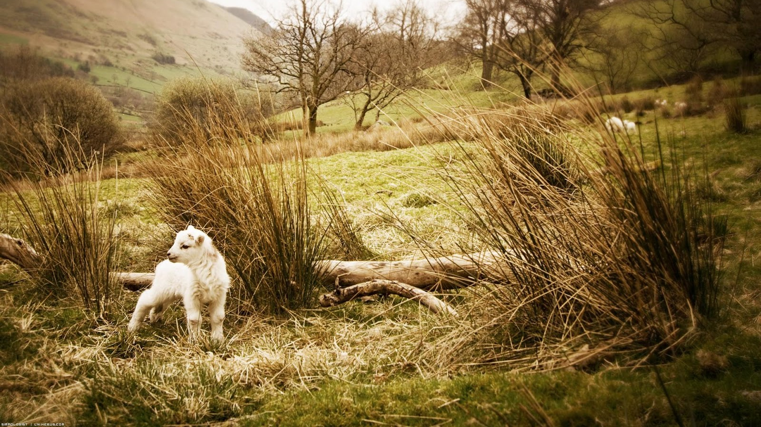
Sheep

Slide 8
Sheep
No defense system
Follow a shepherd
Prone to wander
Helpless
Believers & non-believers

Slide 9
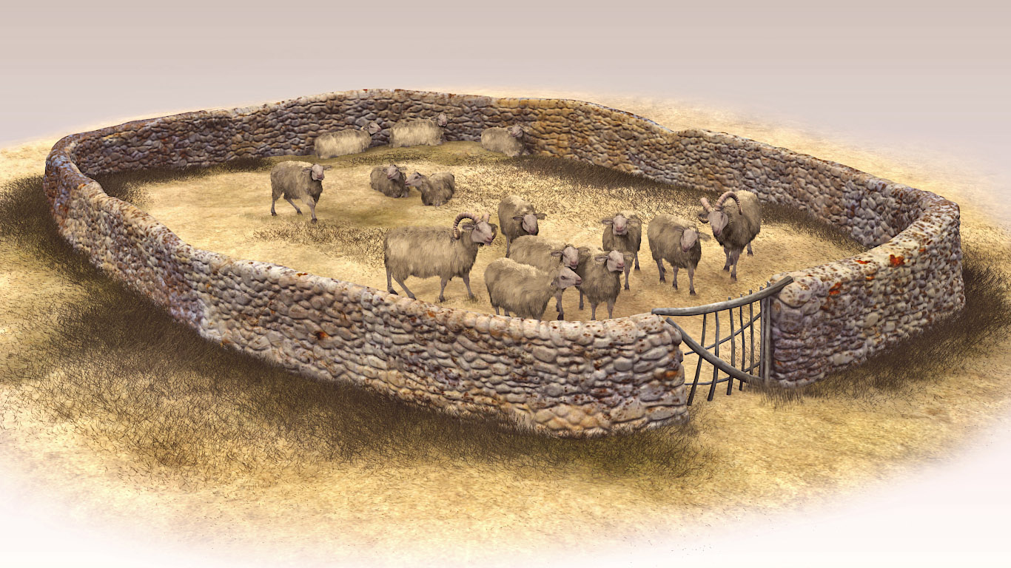
Sheep Pen

Slide 10
Sheep Pen
Place for believers
Place of acceptance by God
Place of security in God’s presence
The Kingdom of God (Heaven & Earth)
The Church (Earth)

Slide 11
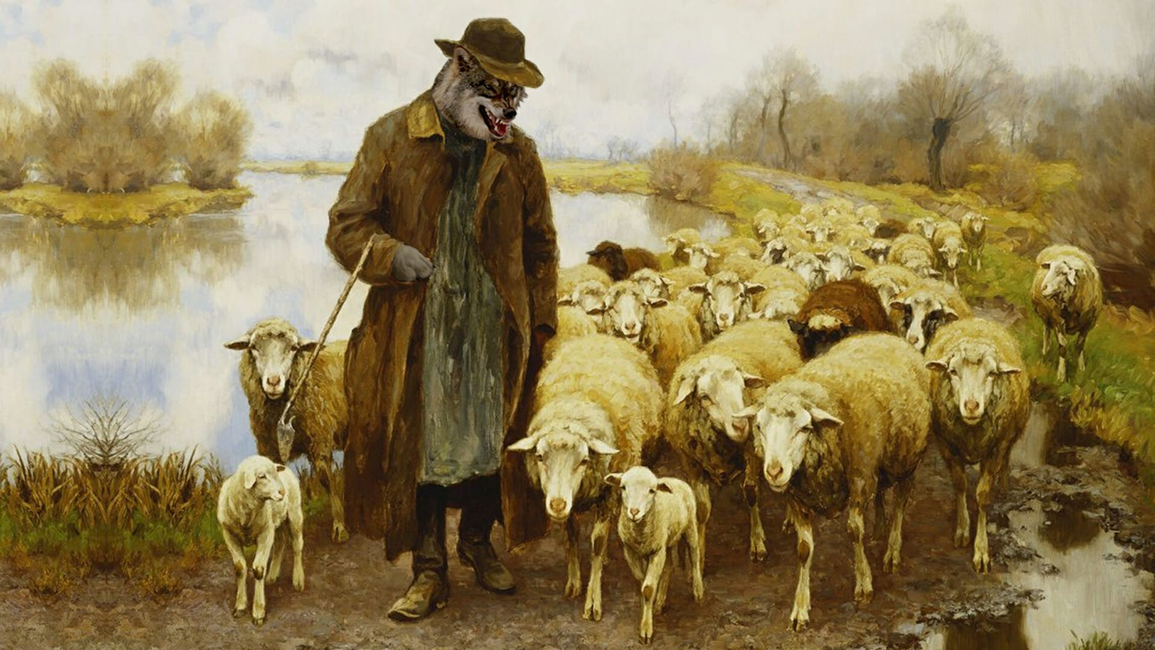
False Shepherd (s)

Slide 12
False Shepherds
Jewish leaders (mocked blind man healed by Jesus)
Thieves & robbers (Satan’s hands & feet)
Powerless to lead true sheep
Indicators
Teaches another Savior
Preaches another Gospel
Glorifies another God
Examples today

Slide 13
Indicators
Teaches another Savior
9 Anyone who runs ahead and does not continue in the teaching of Christ does not have God; whoever continues in the teaching has both the Father and the Son.
(2 John 9 NIV)

Slide 14
Indicators
Preaches another Gospel
15 Now, brothers and sisters, I want to remind you of the gospel I preached to you, which you received and on which you have taken your stand. 2 By this gospel you are saved, if you hold firmly to the word I preached to you. Otherwise, you have believed in vain. 3 For what I received I passed on to you as of first importance: that Christ died for our sins according to the Scriptures, 4 that he was buried, that he was raised on the third day according to the Scriptures, (1 Corinthians 15:1-4 NIV)

Slide 15
Indicators
Glorifies another God
1 Blessed is the one who does not walk in step with the wicked or stand in the way that sinners take or sit in the company of mockers, 2 but whose delight is in the law of the Lord, and who meditates on his law day and night. (Psalm 1:1-2 NIV)

Slide 16
Examples
False religions (10,000)
False science (Carl Sagan)
False philosophy (system of beliefs about reality)
Materialism
Worldliness
Fame
Humanism/Civic Religion
Notes:
The New Civic Religion – Humanism and the Future of Christianity. Patrick Sookhdeo

Slide 18
The True Shepherd
Seeks out the sheep given to Him by the Father
Calls them by name
Gives them life
Carries the sheep into the pen
Cares for the them
Protects the sheep
Leads them

Slide 19
The True Shepherd
1 The Lord is my shepherd, I lack nothing. 2 He makes me lie own in green pastures, he leads me beside quiet waters, 3 he refreshes my soul. He guides me along the right paths for his name’s sake. 4 Even though I walk through the darkest valley, I will fear no evil, for you are with me; your rod and your staff, they comfort me. 5 You prepare a table before me in the presence of my enemies. You anoint my head with oil; my cup overflows. 6 Surely your goodness and love will follow me all the days of my life, and I will dwell in the house of the Lord forever. (Psalm 23 NIV)

Slide 20
John 10 (NIV)
9 I am the gate; whoever enters through me will be saved. They will come in and go out, and find pasture. 10 “The thief comes only to steal and kill and destroy; I have come that they may have life, and have it to the full. 11 I am the good shepherd. The good shepherd lays down his life for the sheep.”

Slide 21
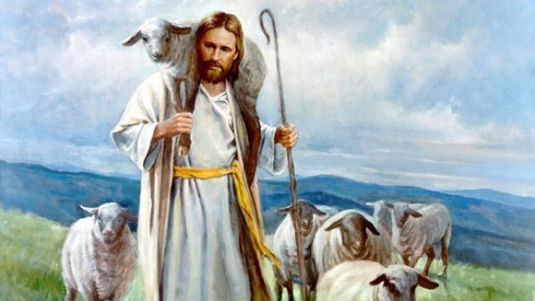
Promises
of the
Good Shepherd

Slide 22
Promises of the Good Shepherd: Saved
Natural man is perishing
Delivered from evil power
Rescued from death (eternal destruction)

Slide 23
Promises of the Good Shepherd: Come in and Go out
Free & Safe
8 the Lord will watch over your coming and going both now and forevermore. (Psalm 121:8 NIV)

Slide 24
Promises of the Good Shepherd: Find Pasture
Soul hunger
Meaning of life
Satisfaction
Emotional
Intellectual
Vocational

Slide 25
Promises of the Good Shepherd: Full Life
Satisfaction
Enjoyment
Without fear
Security
Personal relationship with Jesus
Fruit filled

Slide 26
Promises of the Good Shepherd: Full Life
22 But the fruit of the Spirit is love, joy, peace, forbearance, kindness, goodness, faithfulness, 23 gentleness and self-control. Against such things there is no law. (Galatians 5: 22-23 NIV)

Slide 27
Question
Do you know and follow Jesus as the Shepherd of your life?

Slide 28
Jesus,
The Good Shepherd

