Slide 1
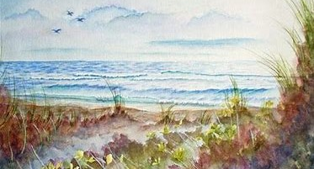
Senior Bible Study Ministry
https://www.seniorbiblestudies.org/

Slide 3
Matthew 2 (NIV)
1 After Jesus was born in Bethlehem in Judea, during the time of King Herod, Magi from the east came to Jerusalem 2 and asked, “Where is the one who has been born king of the Jews? We saw his star when it rose and have come to worship him.” 3 When King Herod heard this he was disturbed, and all Jerusalem with him. 4 When he had called together all the people’s chief priests and teachers of the law, he asked them where the Messiah was to be born.

Slide 4
Matthew 2 (NIV)
5 “In Bethlehem in Judea,” they replied, “for this is what the prophet has written: 6 ‘But you, Bethlehem, in the land of Judah, are by no means least among the rulers of Judah; for out of you will come a ruler who will shepherd my people Israel.’” 7 Then Herod called the Magi secretly and found out from them the exact time the star had appeared. 8 He sent them to Bethlehem and said, “Go and search carefully for the child. As soon as you find him, report to me, so that I too may go and worship him.”

Slide 5
Matthew 2 (NIV)
9 After they had heard the king, they went on their way, and the star they had seen when it rose went ahead of them until it stopped over the place where the child was. 10 When they saw the star, they were overjoyed. 11 On coming to the house, they saw the child with his mother Mary, and they bowed down and worshiped him. Then they opened their treasures and presented him with gifts of gold, frankincense and myrrh.

Slide 6
Matthew 2 (NIV)
12 And having been warned in a dream not to go back to Herod, they returned to their country by another route. 13 When they had gone, an angel of the Lord appeared to Joseph in a dream. “Get up,” he said, “take the child and his mother and escape to Egypt. Stay there until I tell you, for Herod is going to search for the child to kill him.” 14 So he got up, took the child and his mother during the night and left for Egypt, 15 where he stayed until the death of Herod.

Slide 7
Matthew 2 (NIV)
And so was fulfilled what the Lord had said through the prophet: “Out of Egypt I called my son.” 16 When Herod realized that he had been outwitted by the Magi, he was furious, and he gave orders to kill all the boys in Bethlehem and its vicinity who were two years old and under, in accordance with the time he had learned from the Magi. 17 Then what was said through the prophet Jeremiah was fulfilled:

Slide 8
Matthew 2 (NIV)
18 “A voice is heard in Ramah, weeping and great mourning, Rachel weeping for her children and refusing to be comforted, because they are no more.” 19 After Herod died, an angel of the Lord appeared in a dream to Joseph in Egypt 20 and said, “Get up, take the child and his mother and go to the land of Israel, for those who were trying to take the child’s life are dead.” 21 So he got up, took the child and his mother and went to the land of Israel.

Slide 9
Matthew 2 (NIV)
22 But when he heard that Archelaus was reigning in Judea in place of his father Herod, he was afraid to go there. Having been warned in a dream, he withdrew to the district of Galilee, 23 and he went and lived in a town called Nazareth. So was fulfilled what was said through the prophets, that he would be called a Nazarene.

Slide 10
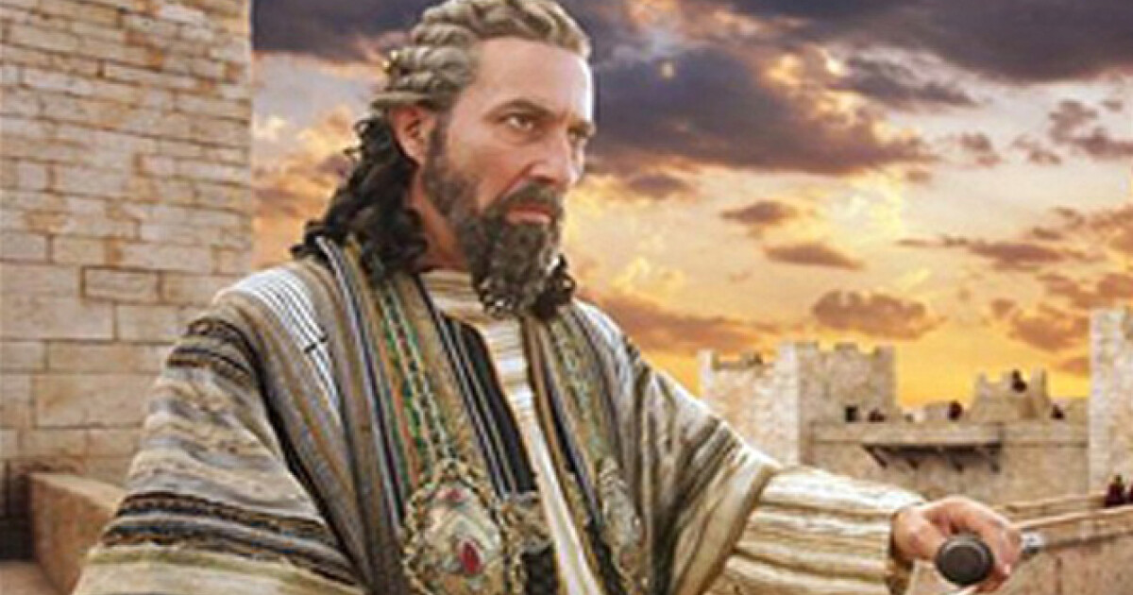
Herod the Great

Slide 11
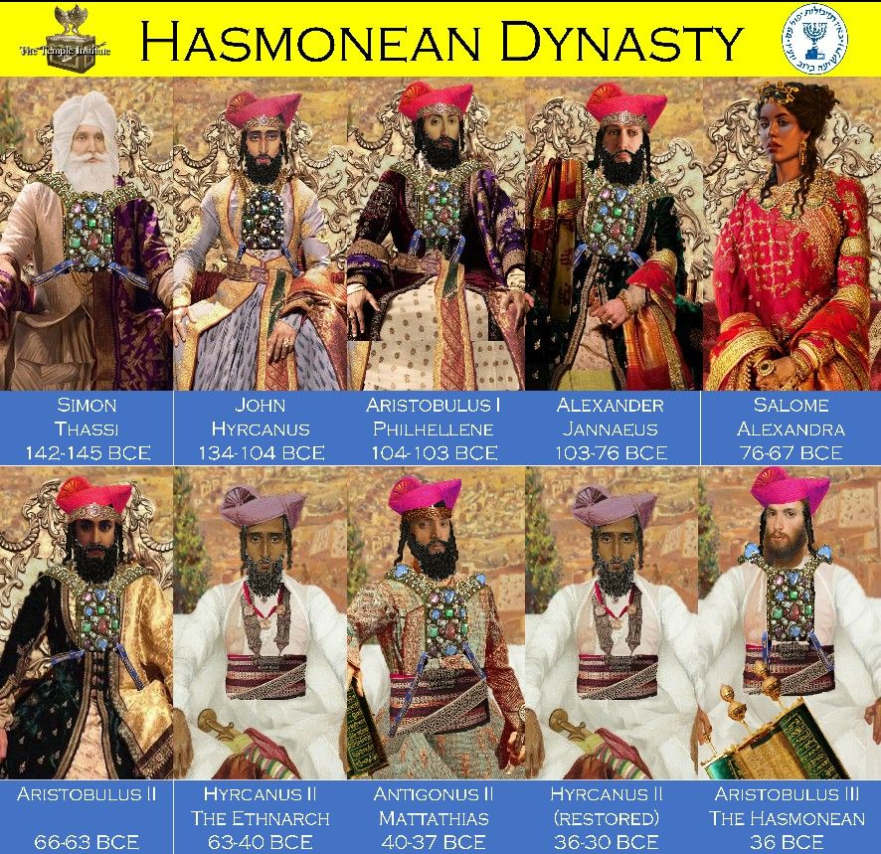

Slide 12
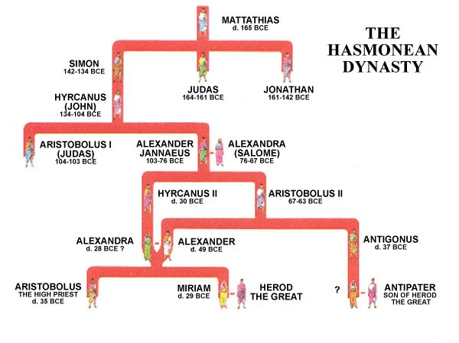

Slide 13
Herod the Great
Herod the Great was the son of a high-ranking official in the Hasmonean dynasty, which was ruling Palestine as an independent kingdom
He was an Edomite (a descendant of Esau)
Herod publicly identified himself as a Jew, although he was not faithful to observe Jewish Law
In 41 BC Herod the Great was named governor of Galilee

Slide 14
Herod, the Great
He was given the title King of the Jews by the Roman Senate
He was charged with the responsibility of conquering Judea so that he could rule as a client king
As king of Judea, Herod the Great’s primary directive was to carry out the wishes of Rome

Slide 15
Herod, the Great
Herod tried to foster good will among the people by
Reducing taxes
Enacting policies that helped bring about economic prosperity
Building public works
In order to gain favor with the Jews, he greatly enlarged & updated the temple in Jerusalem to a size & magnificence greater than Solomon’s temple

Slide 16
Herod, the Great
This renovated structure became known as Herod’s temple
Despite his brilliant & ambitious building projects, Herod the Great had a dark side that showed itself in the events of Matthew
When placed in this context, the incident in Matthew 2 does not seem out of character

Slide 17
Herod, the Great
Herod the Great was an ambitious & ruthless ruler who set himself in opposition to the King of kings & Lord of lords
The Magi from the East came to Jerusalem looking for the one who had been born King of the Jews
They got Herod’s attention, as this was his title

Slide 18
Herod, the Great
As the Magi left for Bethlehem to find the Messiah, Herod asked them to report back to him with the location of the newborn King
When Herod realizes that the Magi have not reported back to him, he was furious
He orders the slaughter of all the boys up to two years old in Bethlehem & the surrounding area, hoping to end the life of any potential rival

Slide 19
Herod, the Great
This is Herod the Great’s biblical legacy
With His Heavenly Father’s protection, Jesus was not harmed
Joseph flees to Egypt with Jesus & Mary

Slide 20
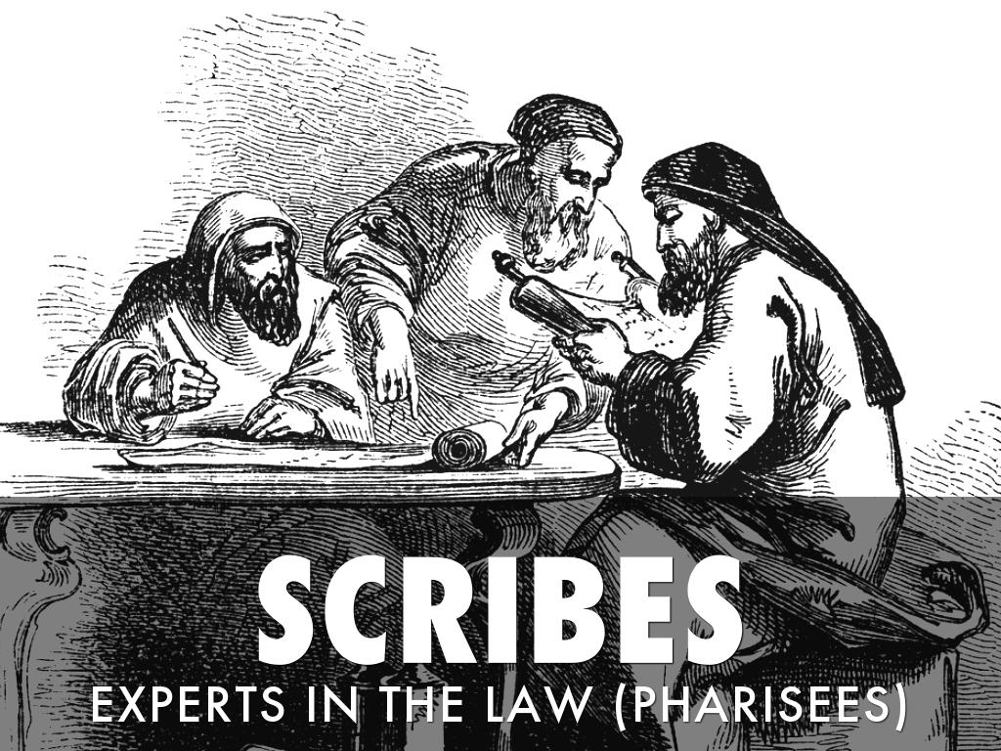

Slide 21
The Scribes
The scribes were “the teachers of the law”
They were experts in the Old Testament
They knew the prophecies (Numbers 24:17), but with the news of the star, they did nothing to seek, worship or adore the promised Messiah
To know God’s revealed truth & take no action to have a personal relationship with Jesus or even seek Him is basic unbelief

Slide 22
The Scribes
A mere outward form of religion cannot hide from God the true inward indifference of heart
The proof of faith is responsive, active obedience

Slide 24
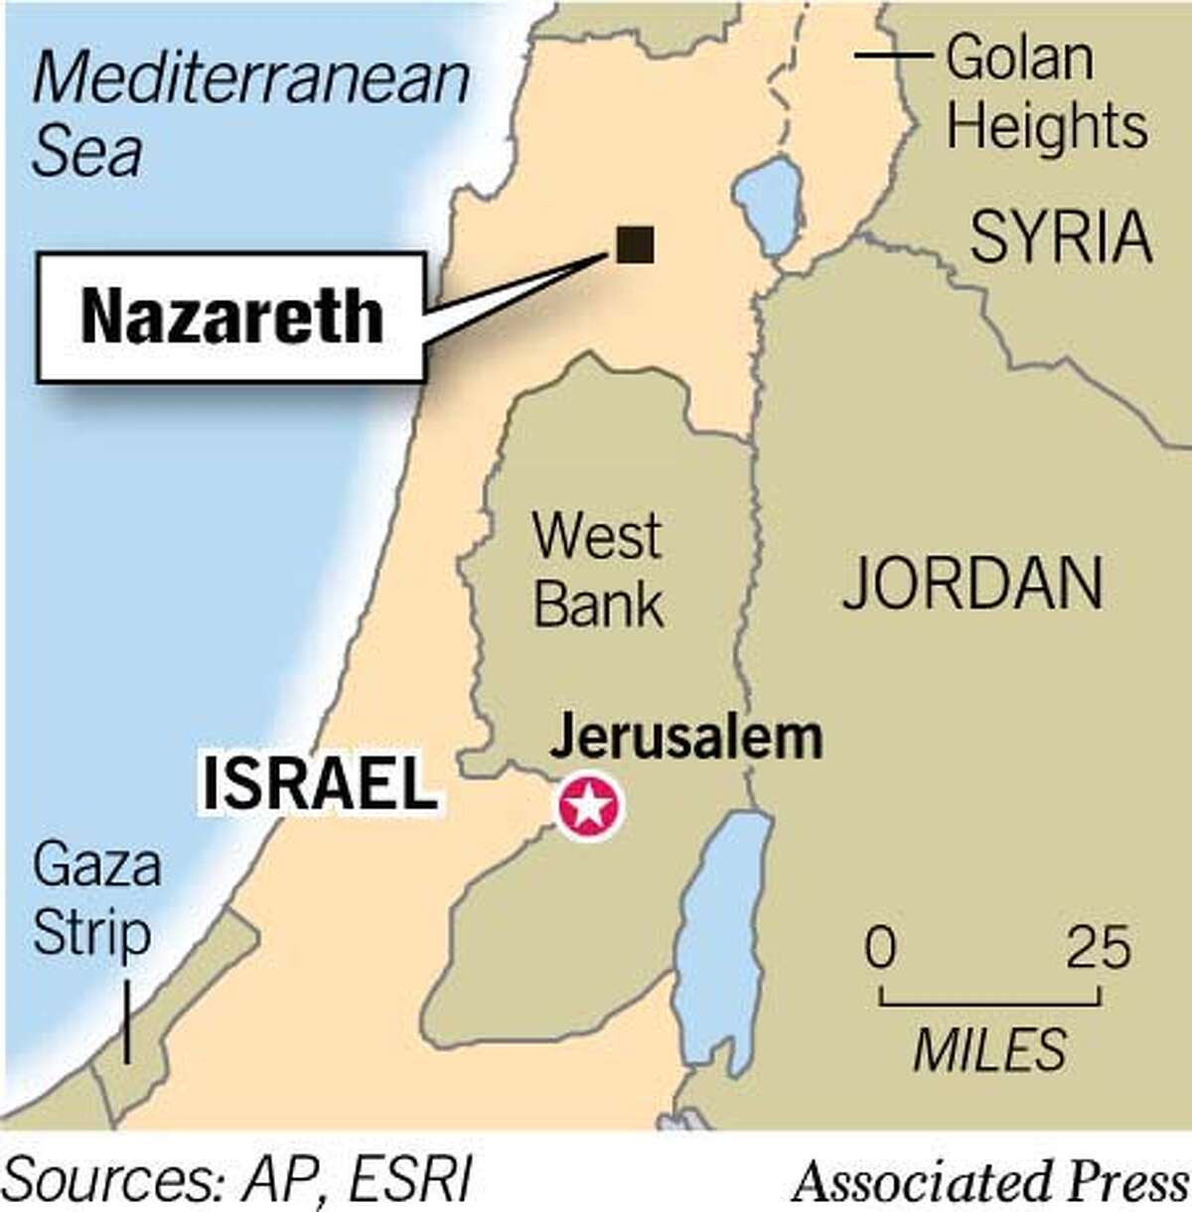

Slide 25
Jesus the Nazarene
When Joseph returned to Israel from Egypt, they settled in Nazareth
Nazareth was a village of no more than 500 people in the days when Jesus grew up there
It was about 16 miles southwest of the Sea of Galilee
It was not on any travel routes
It was in the backwoods or out in the sticks, a small village

Slide 26
Jesus, the Nazarene
In the eyes of more educated & urban Jews, the Nazarenes would have been judged as ignorant at best & perhaps as simple-minded sinners at worst
Isaiah’s prophesy about the Messiah fits Jesus of Nazareth
(Isaiah 52:1-3)

Slide 27
Jesus, the Nazarene
1 Who has believed our message and to whom has the arm of the Lord been revealed? 2 He grew up before him like a tender shoot, and like a root out of dry ground. He had no beauty or majesty to attract us to him, nothing in his appearance that we should desire him. 3 He was despised and rejected by mankind, a man of suffering, and familiar with pain. Like one from whom people hide their faces he was despised, and we held him in low esteem. (Isaiah 52:1-3 NIV)

Slide 28
Jesus, the Nazarene
Jesus identified with humanity by coming to our world
He also identified with the lowly of this world
His upbringing in an obscure & despised town served as an important part of His mission
Jesus identified Himself as “Jesus of Nazareth” during His encounter with Saul on the road to Damascus (Acts 22:7–8)

Slide 29
Jesus, the Nazarene
One of the names of the early Christians was “Nazarenes” (Acts 24:5), and the term Nasara, meaning “Nazarene,” is still used today by Muslims to identify a Christian

Slide 30
Main Idea
The birth of Jesus, the King of the Jews was a blessing to those who were humbly seeking Him and a threat to those who held political and religious power and authority.

Slide 31
Question?
Are you humbly seeking to worship Jesus, the Sovereign King of the heaven and earth?

Slide 33
Senior Bible Study Ministry
https://www.seniorbiblestudies.org/

