Slide 1
Music
Courageous (Casting Crowns)
Standing On The Promises (The Ben Speer Singers)
Trust and Obey (The Vagle Brothers)
We Believe (Newsboys)
1

Slide 2
2

Slide 3
3

Slide 4
Big Idea
Strength and Courage
are not found within you
but in knowing that God is with you.
4

Slide 5
1 After the death of Moses the servant of the Lord, the Lord said to Joshua the son of Nun, Moses' assistant, 2 “Moses my servant is dead. Now therefore arise, go over this Jordan, you and all this people, into the land that I am giving to them, to the people of Israel. 3 Every place that the sole of your foot will tread upon I have given to you, just as I promised to Moses. 4 From the wilderness and this Lebanon as far as the great river, the river Euphrates, all the land of the Hittites to the Great Sea toward the going down of the sun shall be your territory. 5 No man shall be able to stand before you all the days of your life. Just as I was with Moses, so I will be with you. I will not leave you or forsake you. (Joshua 1:1-5)
.
5

Slide 6
6 Be strong and courageous, for you shall cause this people to inherit the land that I swore to their fathers to give them. 7 Only be strong and very courageous, being careful to do according to all the law that Moses my servant commanded you. Do not turn from it to the right hand or to the left, that you may have good success wherever you go. 8 This Book of the Law shall not depart from your mouth, but you shall meditate on it day and night, so that you may be careful to do according to all that is written in it. For then you will make your way prosperous, and then you will have good success. 9 Have I not commanded you? Be strong and courageous. Do not be frightened, and do not be dismayed, for the Lord your God is with you wherever you go.” (Joshua 1:6-9)
6

Slide 7
God With Us
Joshua was one the spies that were sent out to scout the Promised Land the first time the Israelites got there.
After the 40 years of wandering, Joshua emerges again as the one who is called by God to lead the Israelites into the Promised Land.
In the midst of fear, God told Joshua to be strong and courageous because He was with him.
For believers, Jesus has fulfilled every promise through the cross and resurrection and has given us the opportunity to be with Him as sons and daughters.
7

Slide 8
Sermon
Pastor Joby Martin
Lead Pastor
Church of Eleven22
8

Slide 9
6 Be strong and courageous, for you shall cause this people to inherit the land that I swore to their fathers to give them. (Joshua 1:6)
9

Slide 10
10

Slide 11
God Keeps His Promises
Joshua could trust God with the future because of the past.
God was faithful to His people even when they were not faithful to Him.
God is compassionate and merciful and slow to anger.
God revealed His character to Joshua and He has revealed His character to us.
We can trust God with our future because of what He has done for us in the past.
God sent Jesus to fulfill every Messianic prophecy and promise.
He sent the Messiah when we were His enemies and Jesus humbled Himself to the point of death so we could have life.
11

Slide 12
7 So Jesus again said to them, “Truly, truly, I say to you, I am the door of the sheep. 8 All who came before me are thieves and robbers, but the sheep did not listen to them. 9 I am the door. If anyone enters by me, he will be saved and will go in and out and find pasture. 10 The thief comes only to steal and kill and destroy. I came that they may have life and have it abundantly. (John 10:7-10)
12

Slide 13
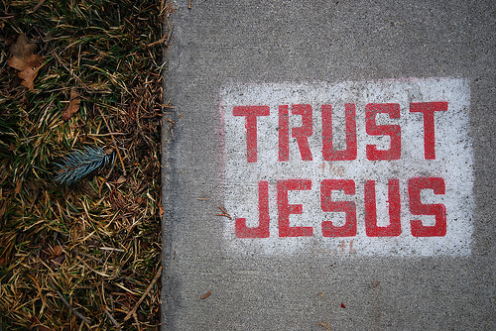
13

Slide 14
Trust Jesus
We have a real enemy who wants to ruin us and everyone around us.
We know he has already been defeated, but until Christ returns, we will be in a spiritual battle.
We will be lied to and tempted which means that we must actually believe what God has told us.
We must actually claim His promises and we must actually trust that He is with us always.
14

Slide 15
4 Abide in me, and I in you. As the branch cannot bear fruit by itself, unless it abides in the vine, neither can you, unless you abide in me. 5 I am the vine; you are the branches. Whoever abides in me and I in him, he it is that bears much fruit, for apart from me you can do nothing. 6 If anyone does not abide in me, he is thrown away like a branch and withers; and the branches are gathered, thrown into the fire, and burned. 7 If you abide in me, and my words abide in you, ask whatever you wish, and it will be done for you. 8 By this my Father is glorified, that you bear much fruit and so prove to be my disciples. 9 As the Father has loved me, so have I loved you. Abide in my love. 10 If you keep my commandments, you will abide in my love, just as I have kept my Father's commandments and abide in his love. (John 15:4-10)
15

Slide 16
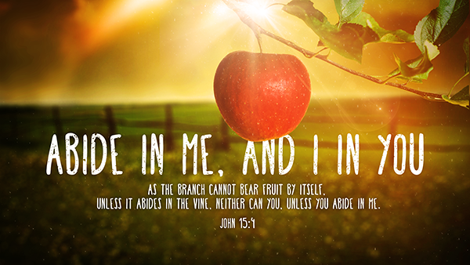
16

Slide 17
Abide in Christ
We abide in Christ when we stay in His Word which He has given us to know Him and hear Him.
Scripture is not just words, but it is alive and active.
It is our sword and it is our shield.
It is how we know God is with us.
The more we have it written on our hearts, the more we can believe He is who He says He is and He does what He says He will do.
17

Slide 18
18

