Slide 1
Senior Bible Study Ministry
https://www.seniorbiblestudies.org/

Slide 3
The Gospel of Matthew
Written around 60 AD
Not the earliest Gospel, but so important it was placed first in the New Testament canon
Presents Jesus as
Descendant of Abraham
Direct heir of David’s throne
Messiah in fulfillment of prophesies

Slide 4
The Gospel of Matthew
The book includes five main discourses
Sermon on the Mount
Parables of the Kingdom
Teaching on humility & forgiveness
Discourse on the last days
Apostolic Commission

Slide 5
The Gospel of Matthew
Matthew organized Jesus’ Miracles (27)
Healing (15)
Casts out demons (3)
Feeds 1000s (2)
Transfiguration (1)
Calms the sea (1)
Walks on water (1)
Raises Jairus’ daughter from dead (1)
Coin in fish’s mouth (1)
Cleanses from leprosy (1)
Curses a tree (1)

Slide 6
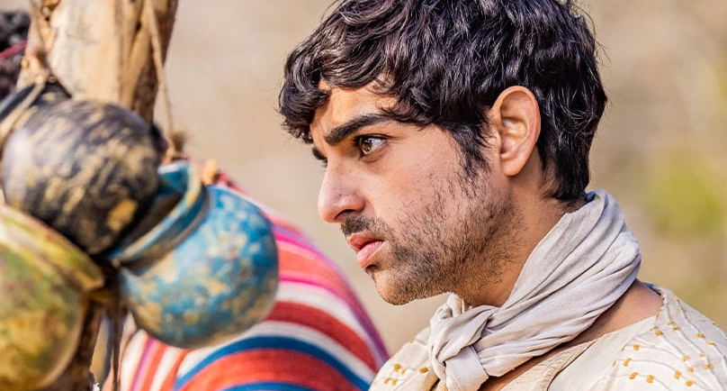
Who Is
Matthew?

Slide 7
Who Is Matthew?
Before Jesus called Matthew to be His disciple, he was called “Levi, the Publican”
Publican was a term of contempt used to describe a customs officer (tax collector) for the Romans
Although he was probably was well educated & fluent in several languages, he was an outcast from Jewish society
He probably used his ability to keep detailed notes & records to documents his time with Jesus

Slide 9
Genealogy of Jesus
Bible genealogies help substantiate its historical accuracy
These lists confirm the physical existence of the characters in the Bible
By knowing family histories, we understand that the Bible is far from a mere story or a parable for how we should live our lives
It is authentic, historical truth

Slide 10
Genealogy of Jesus
This genealogy attests to Jesus’ fulfillment of Old Testament prophecies
Genealogies also demonstrate the detail-oriented nature of God & His interest in individuals
Old Testament genealogies form an authentic record of the continuing fulfillment of God’s promises through the Israelites

Slide 11
Matthew 1 (NIV)
18 This is how the birth of Jesus the Messiah came about: His mother Mary was pledged to be married to Joseph, but before they came together, she was found to be pregnant through the Holy Spirit. 19 Because Joseph her husband was faithful to the law, and yet did not want to expose her to public disgrace, he had in mind to divorce her quietly.

Slide 12
Matthew 1 (NIV)
20 But after he had considered this, an angel of the Lord appeared to him in a dream and said, “Joseph son of David, do not be afraid to take Mary home as your wife, because what is conceived in her is from the Holy Spirit. 21 She will give birth to a son, and you are to give him the name Jesus, because he will save his people from their sins.” 22 All this took place to fulfill what the Lord had said through the prophet:

Slide 13
Matthew 1 (NIV)
23 “The virgin will conceive and give birth to a son, and they will call him Immanuel” (which means “God with us”). 24 When Joseph woke up, he did what the angel of the Lord had commanded him and took Mary home as his wife. 25 But he did not consummate their marriage until she gave birth to a son. And he gave him the name Jesus.

Slide 15
The Birth of Jesus
Matthew does not give a detailed account of Jesus’ birth
He draws attention to two important facts
Old Testament prophecies were fulfilled in Jesus
The Jews needed to know that Jesus born of a virgin
14 Therefore the Lord himself will give you a sign: The virgin will conceive and give birth to a son, and will call him Immanuel. (Isaiah 7:14 NIV)

Slide 17
Jesus Messiah
The word “christos” means Messiah in Hebrew & Christ in Greek
The Messiah is the Anointed One of God
Under the Romans, people felt that God would not wait much longer to send the Messiah to set them free
Many arose who claimed to be the Messiah & led many in rebellion against Rome

Slide 18
Jesus Messiah
Many thought the Messiah would be
Political leader
Military leader
Peacemaker
Sent by God to bring righteousness over all the earth

Slide 19
Jesus Messiah
Jesus saw Himself as Messiah who was a
Prophet (Deuteronomy 18:15-19)
Priest (Psalm 110:4)
King (2 Samuel 7:12-13)

Slide 21
Mary
Gabriel brought Mary the news that she would give birth to a son to reign forever on David’s throne
30 But the angel said to her, “Do not be afraid, Mary; you have found favor with God. 31 You will conceive and give birth to a son, and you are to call him Jesus. 32 He will be great and will be called the Son of the Most High. The Lord God will give him the throne of his father David, 33 and he will reign over Jacob’s descendants forever; his kingdom will never end.” (Luke 1:30-33 NIV)

Slide 22
Mary
God had reasons for choosing the time, places & people involved in His redemption plan
Mary was of the right lineage
She was engaged to a man whose heritage would require him to visit Bethlehem at just the right time
Mary was a virgin

Slide 23
Mary
The virgin birth, in bypassing a human father,
Circumvented the transmission of a sin nature
Allowed the Messiah to be a sinless man
Mary was from Nazareth - Prophecies given hundreds of years before Jesus’ birth declared that the Messiah would be of little reputation (Isaiah 53; Zechariah 9:9)

Slide 24
Mary
Mary was not chosen because she was more holy than other people
She was surely a godly woman, but that is not the point
Gabriel’s emphasis was on Mary’s privilege, not her piety
She was the recipient of God’s grace, His undeserved favor

Slide 25
Mary
Mary gives us an example of total devotion to the Lord
38 “I am the Lord’s servant,” Mary answered. “May your word to me be fulfilled.” Then the angel left her. (Luke 1:38 NIV)
We need the wisdom & grace to answer God’s call, whatever it is, the way Mary did

Slide 26
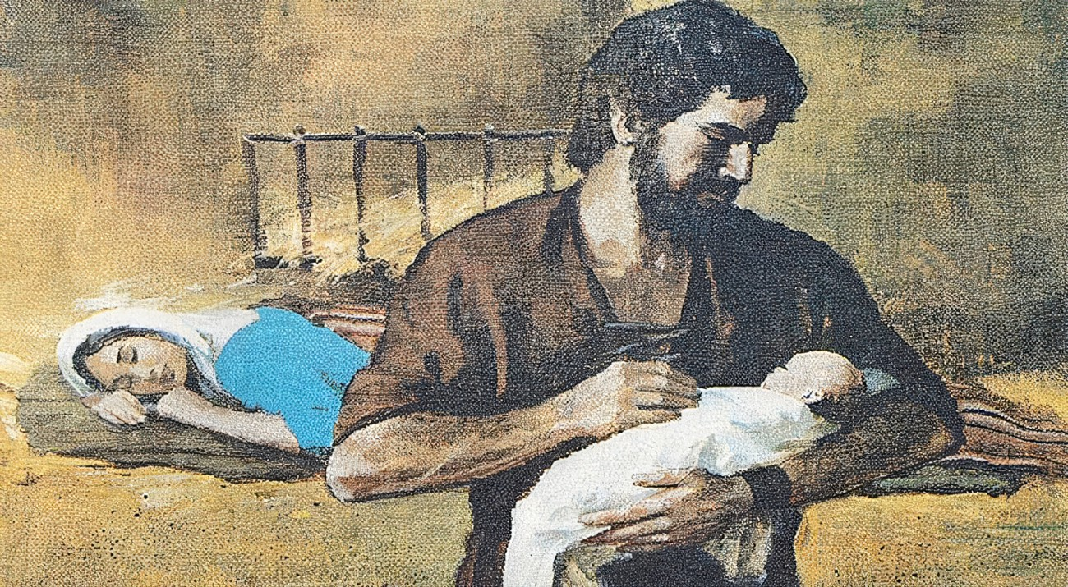
Joseph,
The Earthly Father
Of Jesus

Slide 27
Joseph, the Earthly Father of Jesus
Joseph was a descendant of King David
He also lived in Nazareth in Galilee
Joseph is Jesus’ earthly, adoptive father but not His biological father

Slide 28
Joseph, the Earthly Father of Jesus
Joseph was
Deeply obedient to God
Humble
Kind
Self-sacrificing
He had intended to divorce Mary quietly because he did not want to bring any public shame or disgrace on Mary or her family

Slide 29
Joseph, the Earthly Father of Jesus
When Jesus was an adult, people often referred to Him as the “son of Joseph” (Luke 4:22) & as “the carpenter’s son” (Matthew 13:55)
Whatever Joseph’s vocation, he worked hard to provide for his family
He did what he could to help Jesus grow in “wisdom and stature” (Luke 2:52)

Slide 30
Joseph, the Earthly Father of Jesus
Many to believe that Joseph died sometime between when Jesus was a young boy before He launched His public ministry
As He was dying, Jesus committed the care of His mother to John (John 19:26–27)

Slide 31
Main Idea
Jesus as the Son of God and Son of Man is the Messiah as demonstrated by His fulfillment of Old Testament prophecy and His genealogy.

Slide 32
Question?
Does knowing Jesus’ genealogy and history convince you that He is the promised Messiah in whom you can put your total faith and trust for your eternal salvation?

Slide 34
Senior Bible Study Ministry
https://www.seniorbiblestudies.org/

